Slide 1
Spring Batch

Slide 2
Spring Batch
What is Spring Batch?
Why Spring Batch?

Slide 3
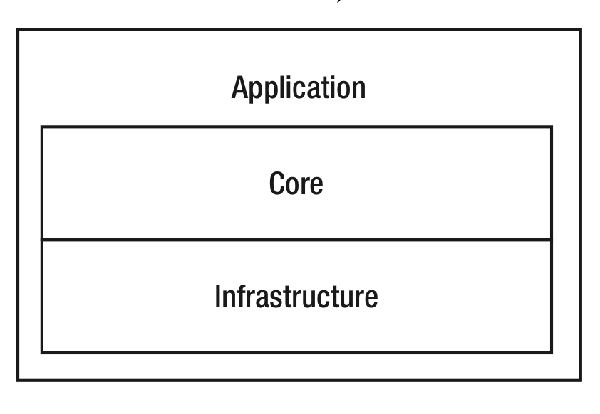
Spring Batch Architecture

Slide 4
A Sample
Job
Step 1
Step 2
Step 3
Step 4
Tasklet
Tasklet
Tasklet
Tasklet

Slide 5
Component and Relationship
JobLauncher
Job
Step
Tasklet
JobRepository

Slide 6
DEMO
Create a helloWorldJob to print the words “Hello World!” to console

Slide 7
JobRepository
BATCH_JOB_INSTANCE
BATCH_JOB_PARAMS
BATCH_JOB_EXECUTION
BATCH_JOB_EXECUTION_CONTEXT
BATCH_STEP_EXECUTION
BATCH_STEP_EXECUTION_CONTEXT

Slide 8
JobParameters
JobParametersValidator
JobParametersIncrementer

Slide 9
Job Listener
JobExecutionListener

Slide 10
Execution Context
JobExecutionContext
StepExecutionContext

Slide 11
Tasklet
CallableTaskletAdapter
MethodInvokingTaskletAdapter
SystemCommandTasklet
Chunk-based Tasklet

Slide 12
Flow Control

